Slide 1
Network and Systems Security (SIL-765)
(Assignment-2)
Made By :-
Ruchir Dhiman (2016MCS2685)
Shantanu Agarwal (2016MCS2661)

Slide 2
Problem Statement and Assumptions
Designing a mechanism to allow for the distribution of the current date and time (GMT), digitally signed using RSA.
The correct time is provided by syncing the time server with the UTC time server. UTC is the reliable source for providing the time.
The public key of the KDC we have used is assumed to be known by the client and the server and KDC have the public key of user and server.
Message latency is assumed to be zero. So, the time received from the server won’t be offset due to transmission time and network delays.

Slide 3
Design
We have 3 entities in our design: 1. A KDC which is used for provide the public keys of the participants. 2. The time server which provides the time. 3. The client which requests the server for the current date and time.
The KDC and the time server are written as online servers in PHP; whereas, the client is written as a python script.
The KDC and time server are hosted on www.shantanu.pro.

Slide 4
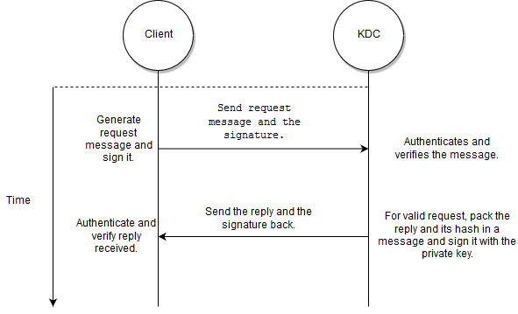
Function of the KDC
The KDC is used by the client to request the public key of the server as shown here:

Slide 5
Function of the KDC
To get the public key of the time server, the client sends a message to the KDC. The signature for this message is also calculated, and is sent along with the message.
The KDC verifies the signature of the client and server based on the message body.
The KDC, then creates a reply with the required public key and signs the message with its own private key, so that the reply can be authenticated.
The client, then, authenticates the message and verifies its integrity, and takes the necessary actions based on whether the message is validated or not.

Slide 6
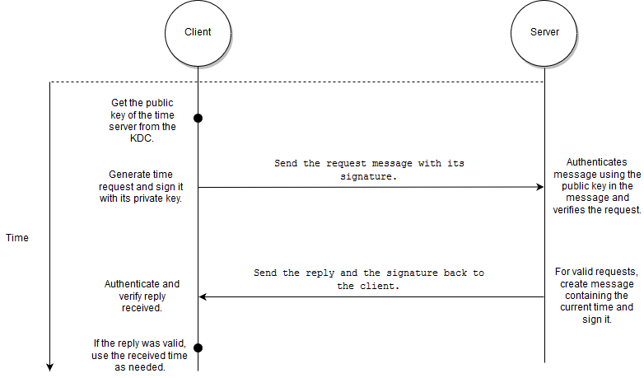
Time Request Procedure
After obtaining the public key of the time server, the client proceeds on to make the time request as shown here:

Slide 7
Time Request Procedure
The client makes the request by generating a message, which contains its public key, signing the message with its private key, and then, sending the message and the signature to the time server.
The server unpacks the public key and authenticates and verifies the message, using the public key received.
If the request is validated, it packs the time into a message, signs the message and sends both the time, and the signature back to the client.

Slide 8
Time Request Procedure
The client will then use the public key of the time server (obtained from the KDC) to validate the message received.
If validation is successful, it will use the time as required, otherwise, it will signal an error.

Slide 9
Thank You

